Slide 1
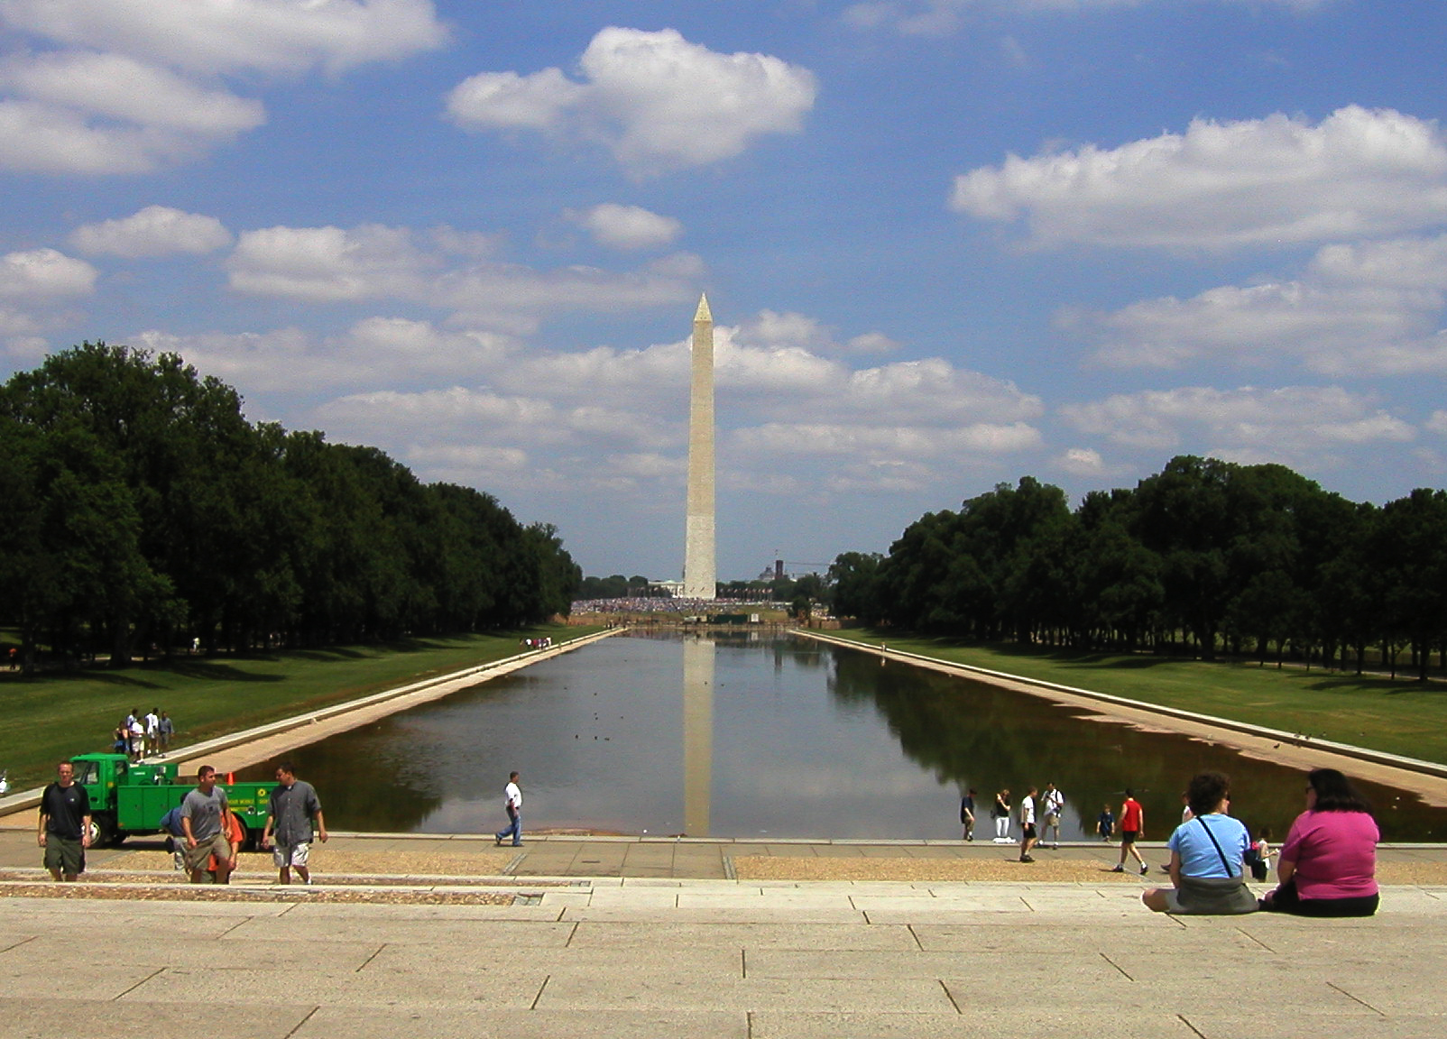
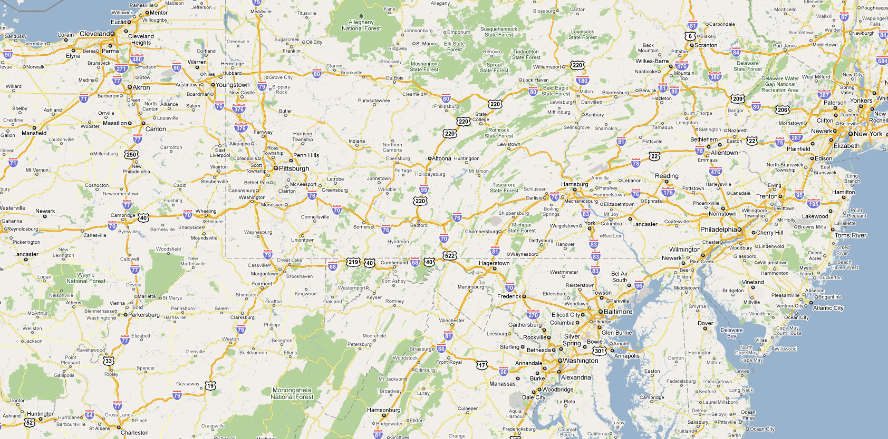
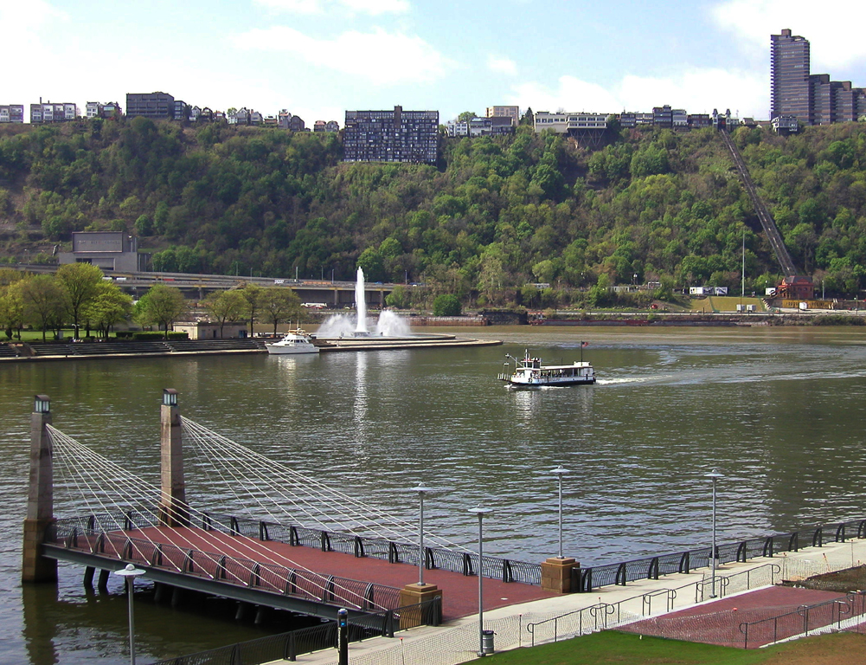
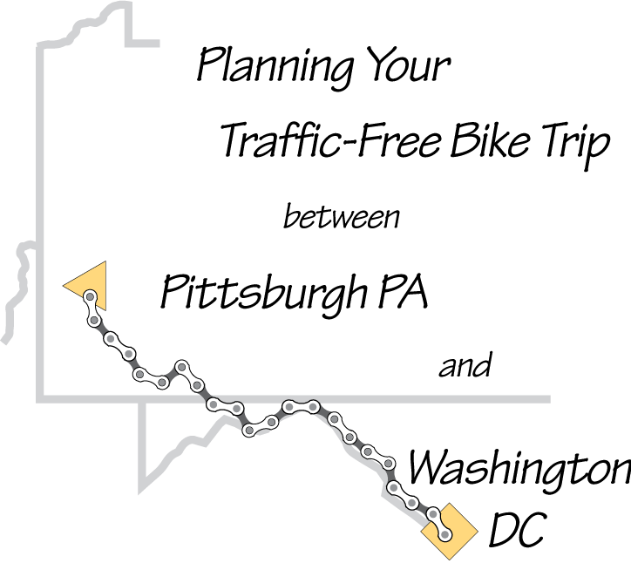
Notes:
On map (layer 1) – where’s that?

Slide 2
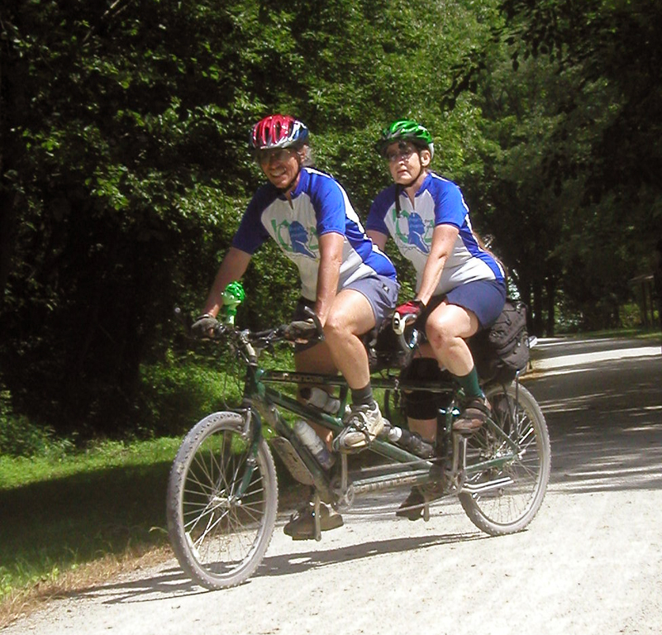
Mary Shaw
Roy Weil
Notes:
Before: Who are you, and what makes you such an expert?
After: OK, what’s the trip like

Slide 3
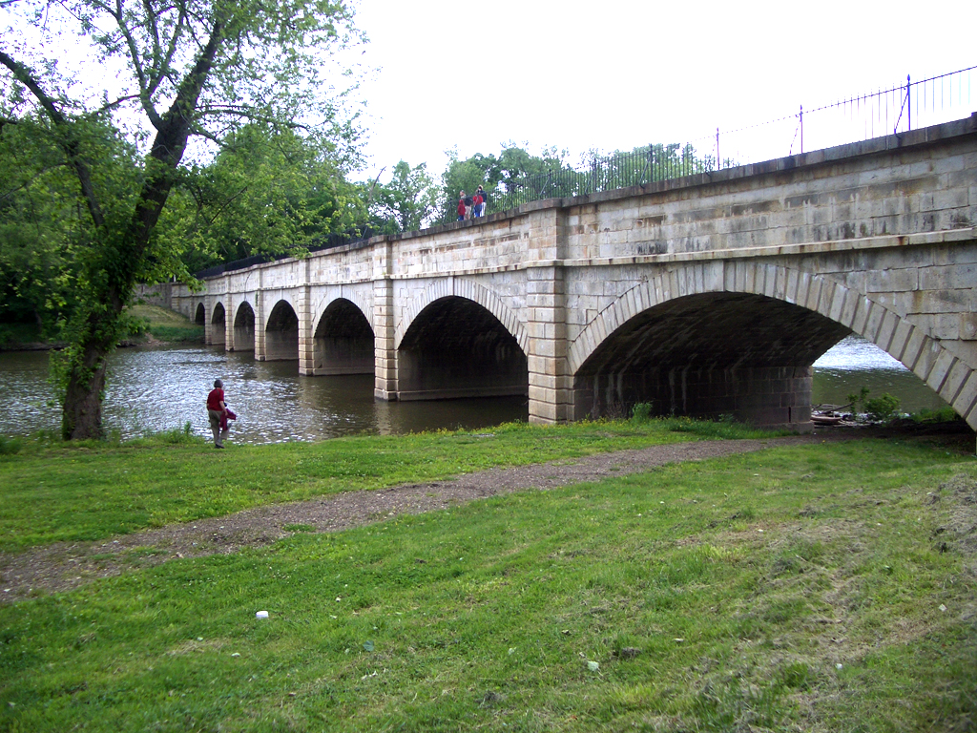
Notes:
If I do this what will I see?

Slide 4
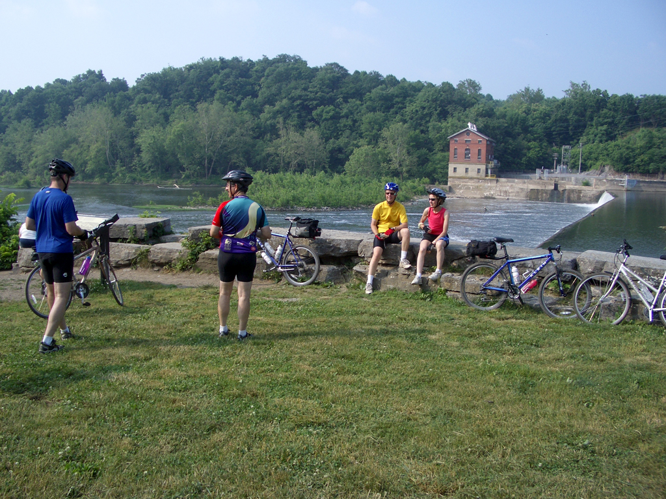

Slide 6
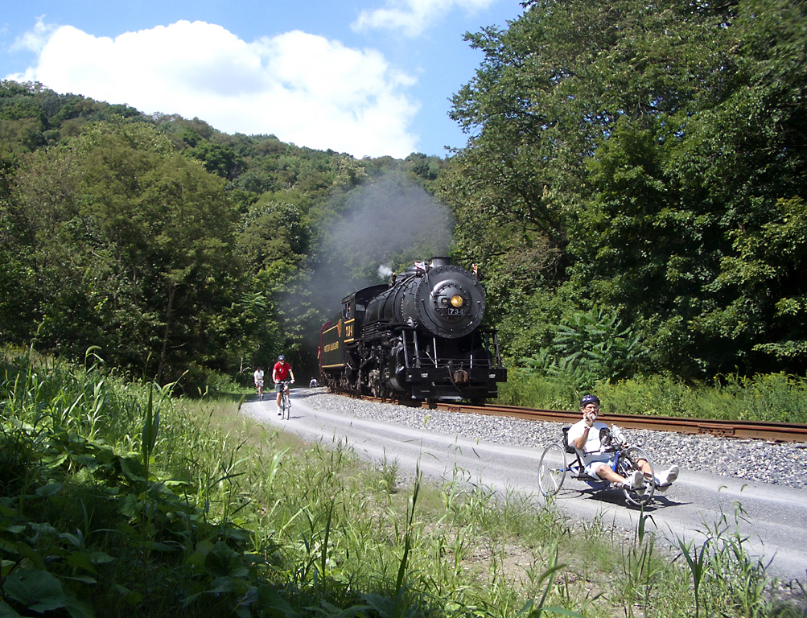

Slide 7
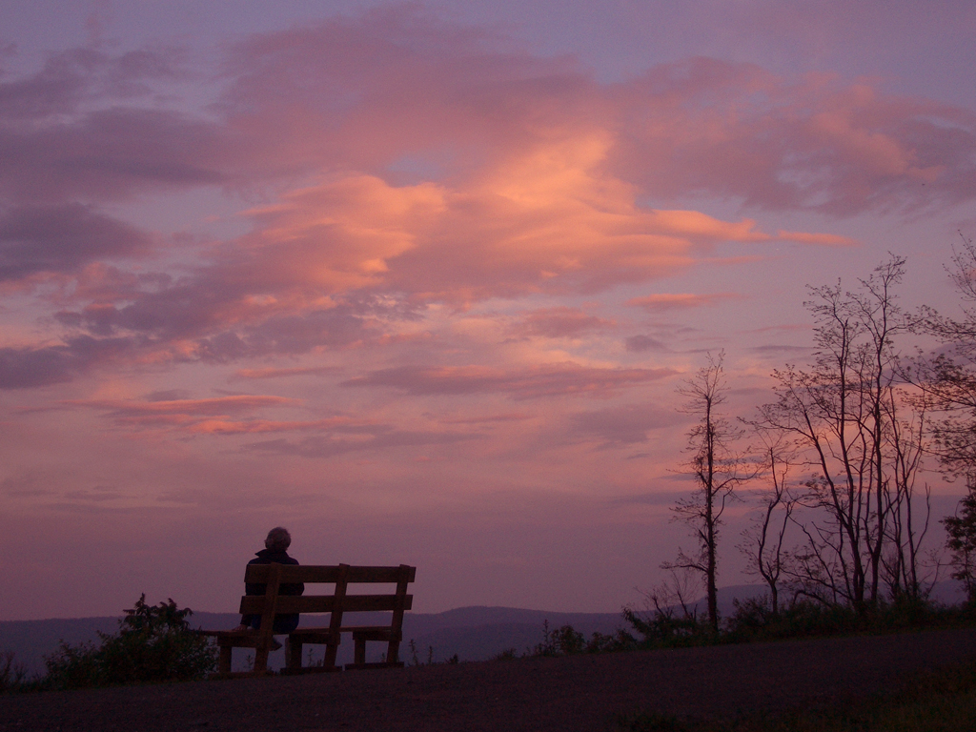

Slide 8
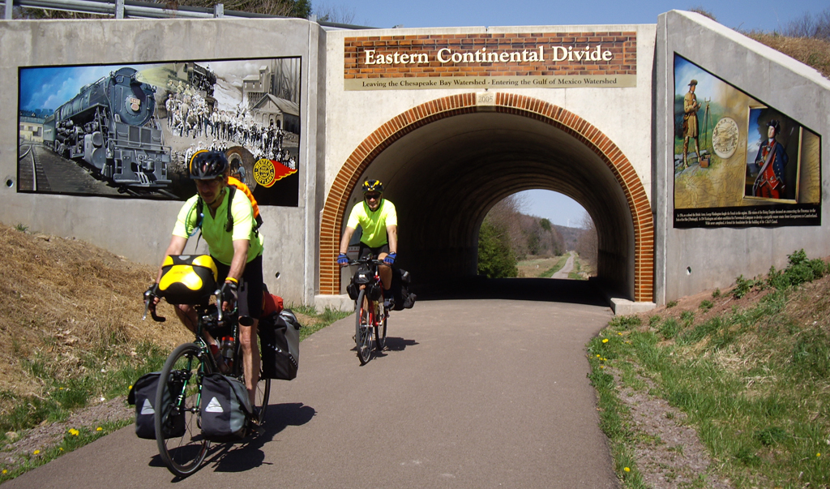

Slide 9
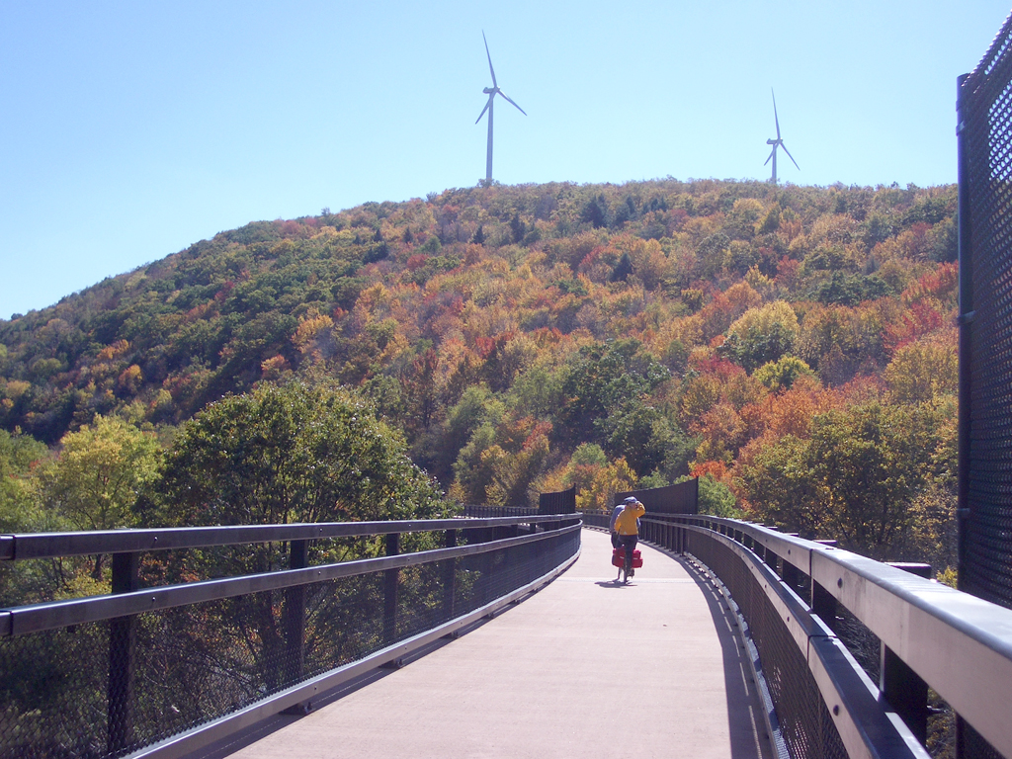

Slide 10
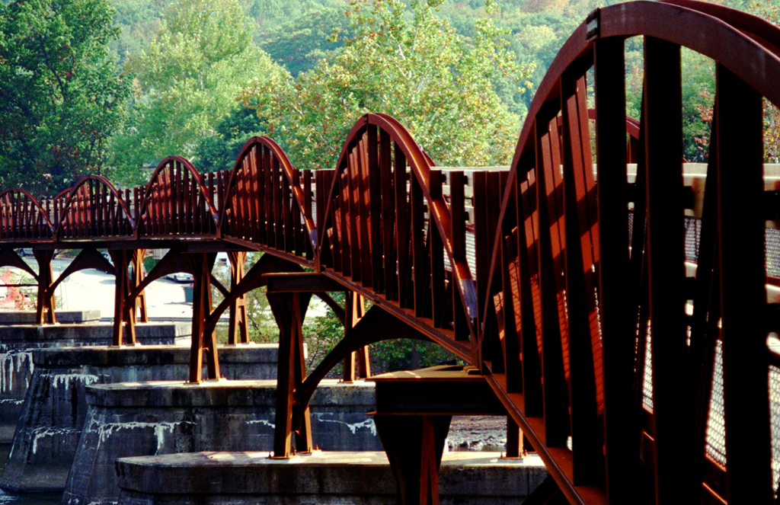

Slide 11
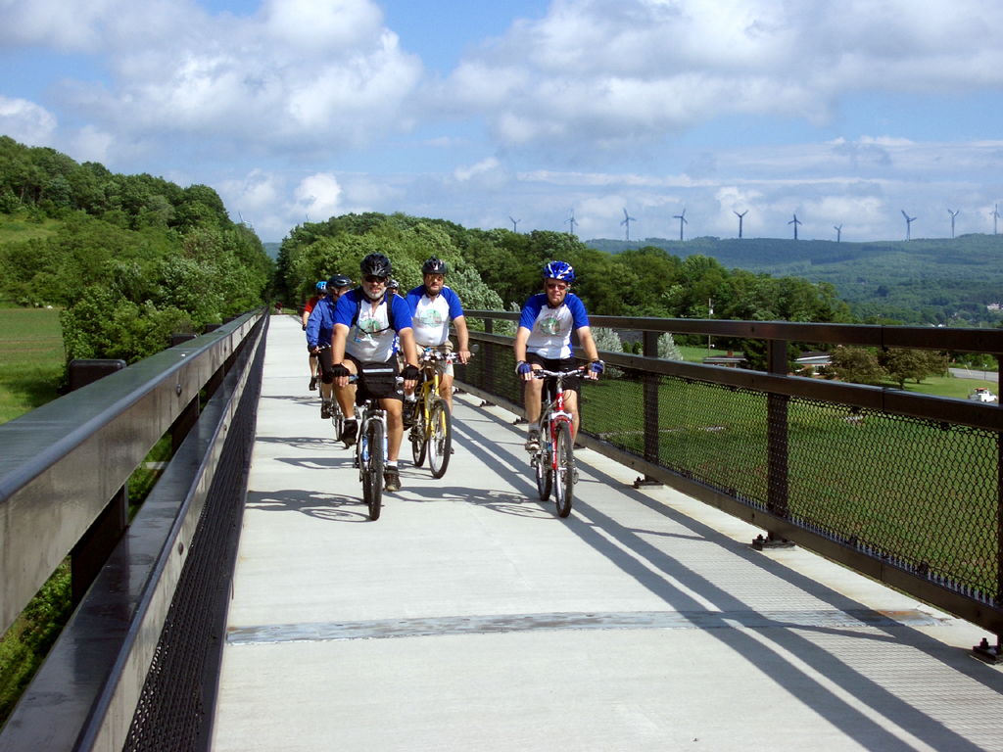

Slide 15
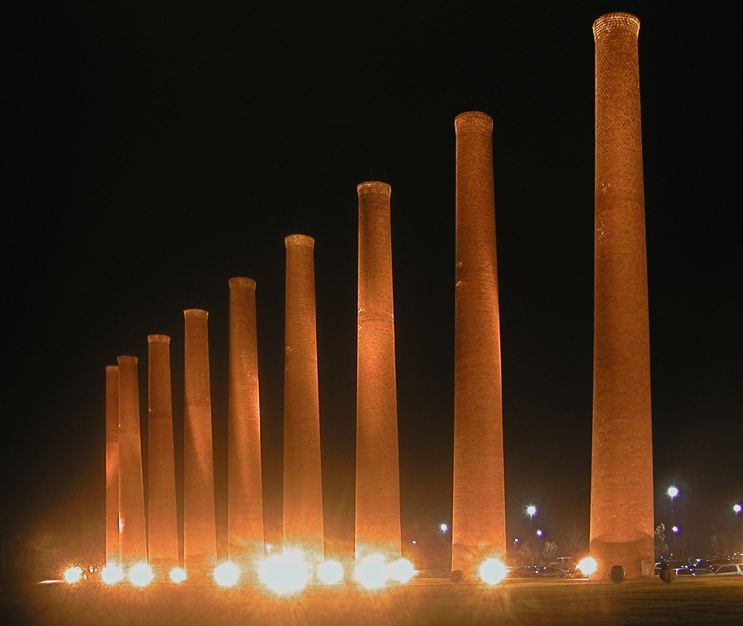
Notes:
Where does it end in Pittsburgh? I have heard about several different locations?

Slide 20
OK, so what does it take
to see all this
from your bicycle?
Notes:
Over sunset: WOW! Looks neat! I really would like to do it some time. What’s involved?
Just your trip, or trips for different folks?

Slide 21
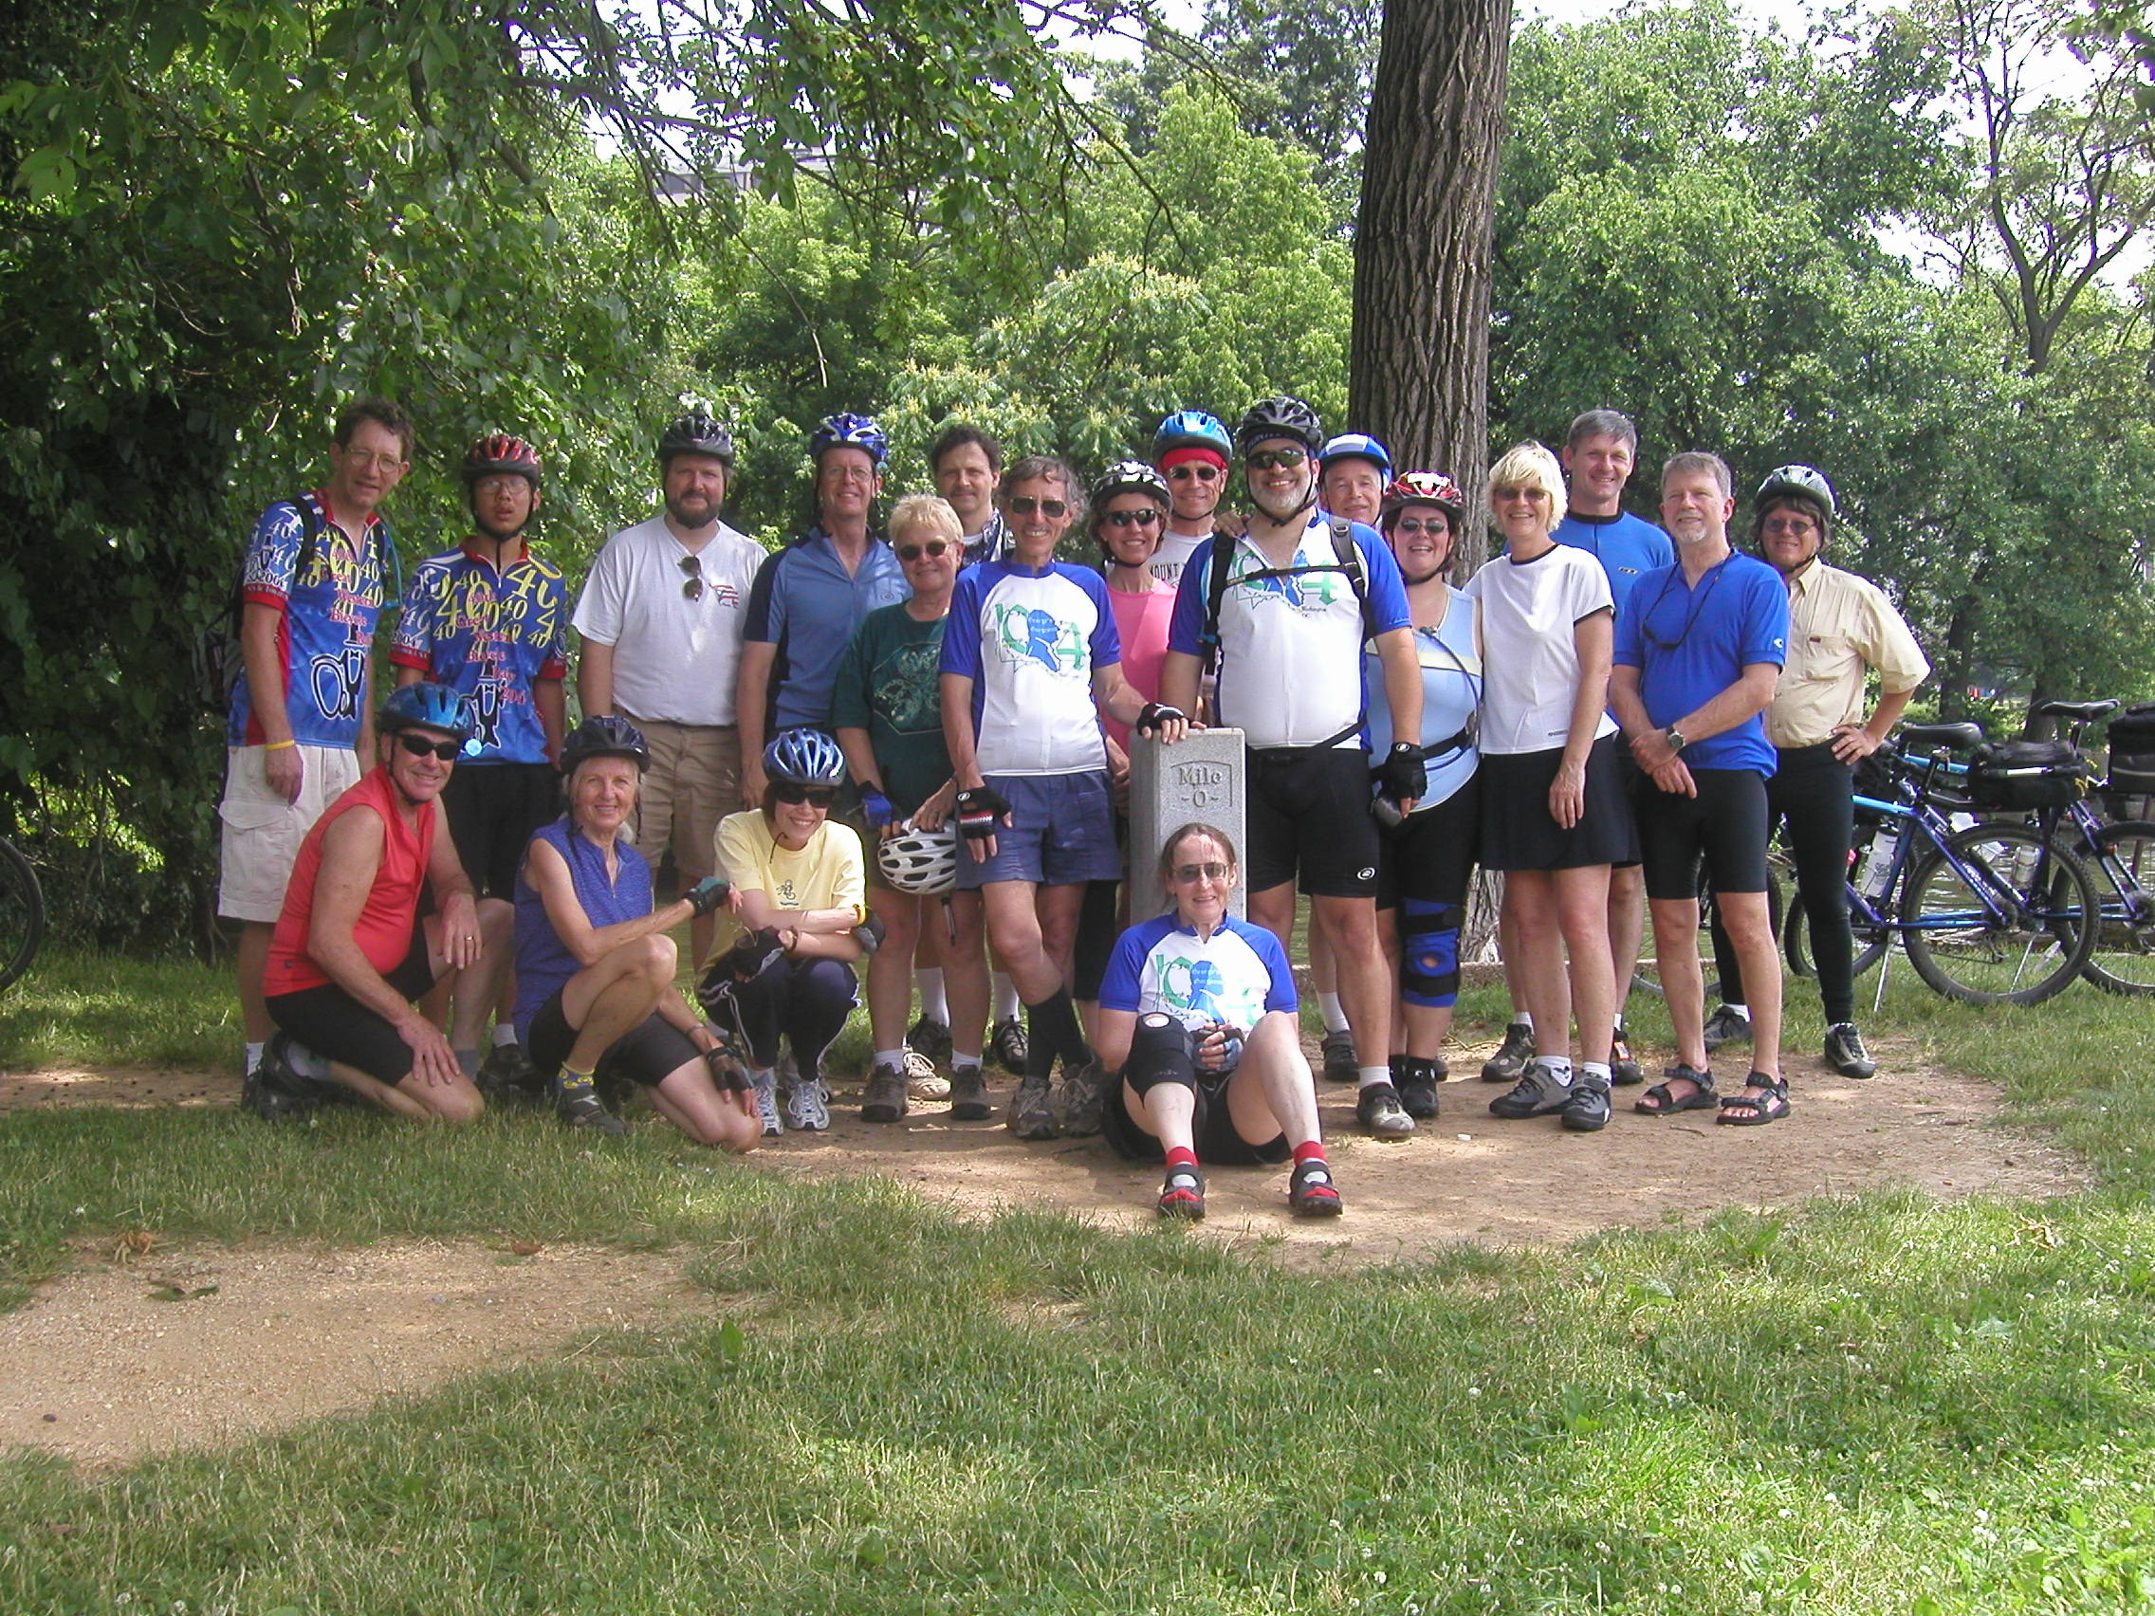

Slide 22
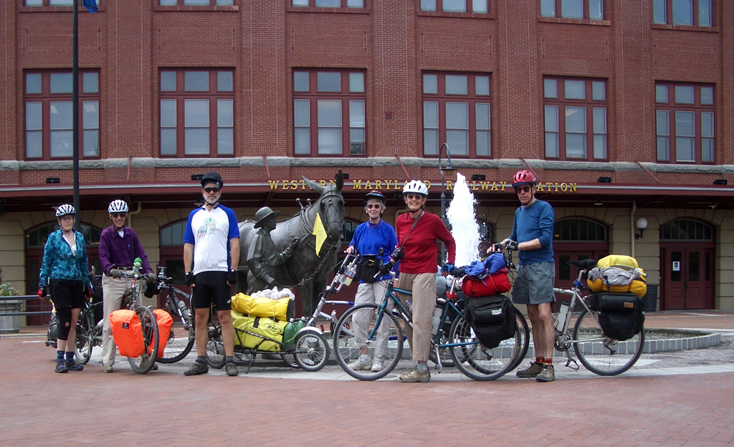

Slide 23
People ask us …
Where does the trail go?
What is the trail like?
What kind of bikes do we need?
Can we do it?
Notes:
(very fast) Where does the trail go? Is it finished? What is the trail like? What kind of bikes do I need? Can I do it?

Slide 24
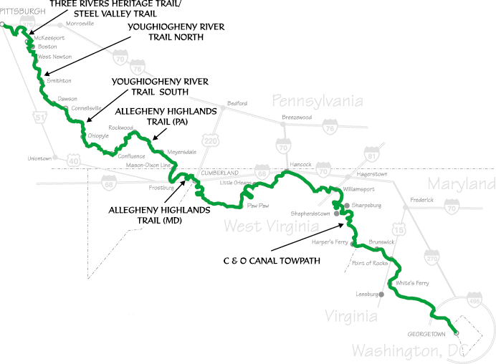
Great Allegheny Passage // C&O Canal
C&O CANAL
TOWPATH

Slide 25
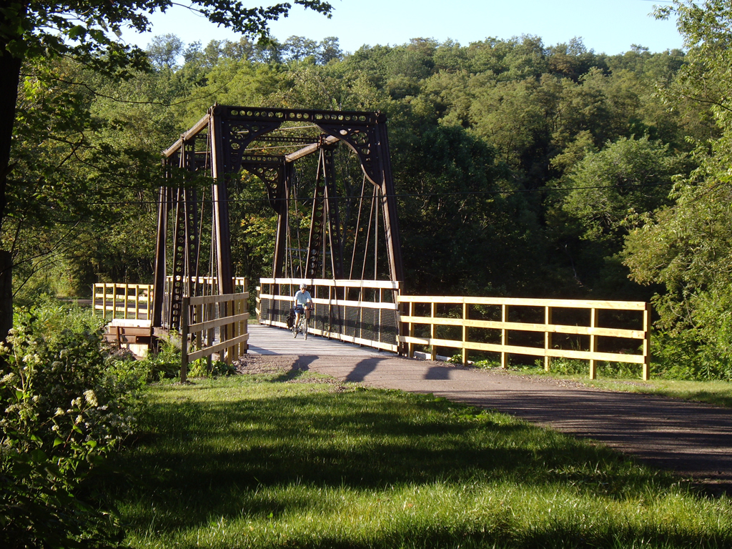
Great Allegheny Passage is packed crushed limestone
Notes:
What’s the trail like?

Slide 26
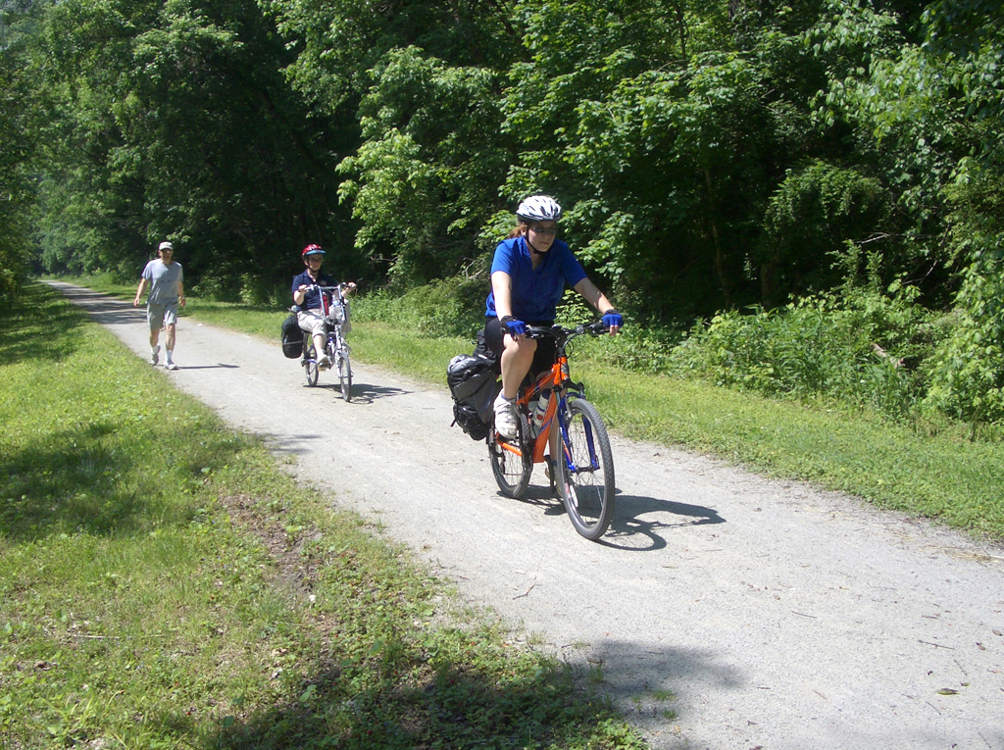
Bike light load
Notes:
What kind of bike? How about those weird bikes that I have seen here locally

Slide 27
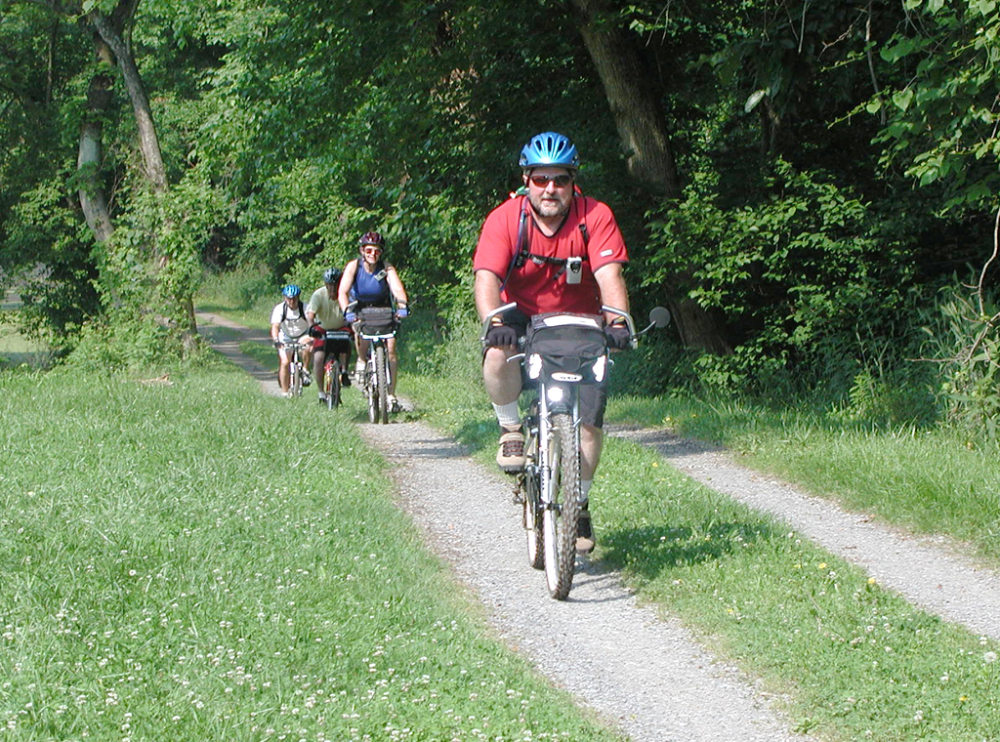
C&O Towpath is often double-track with short hills at locks
Notes:
That looks easy, just like the trails I have ridding around here

Slide 28
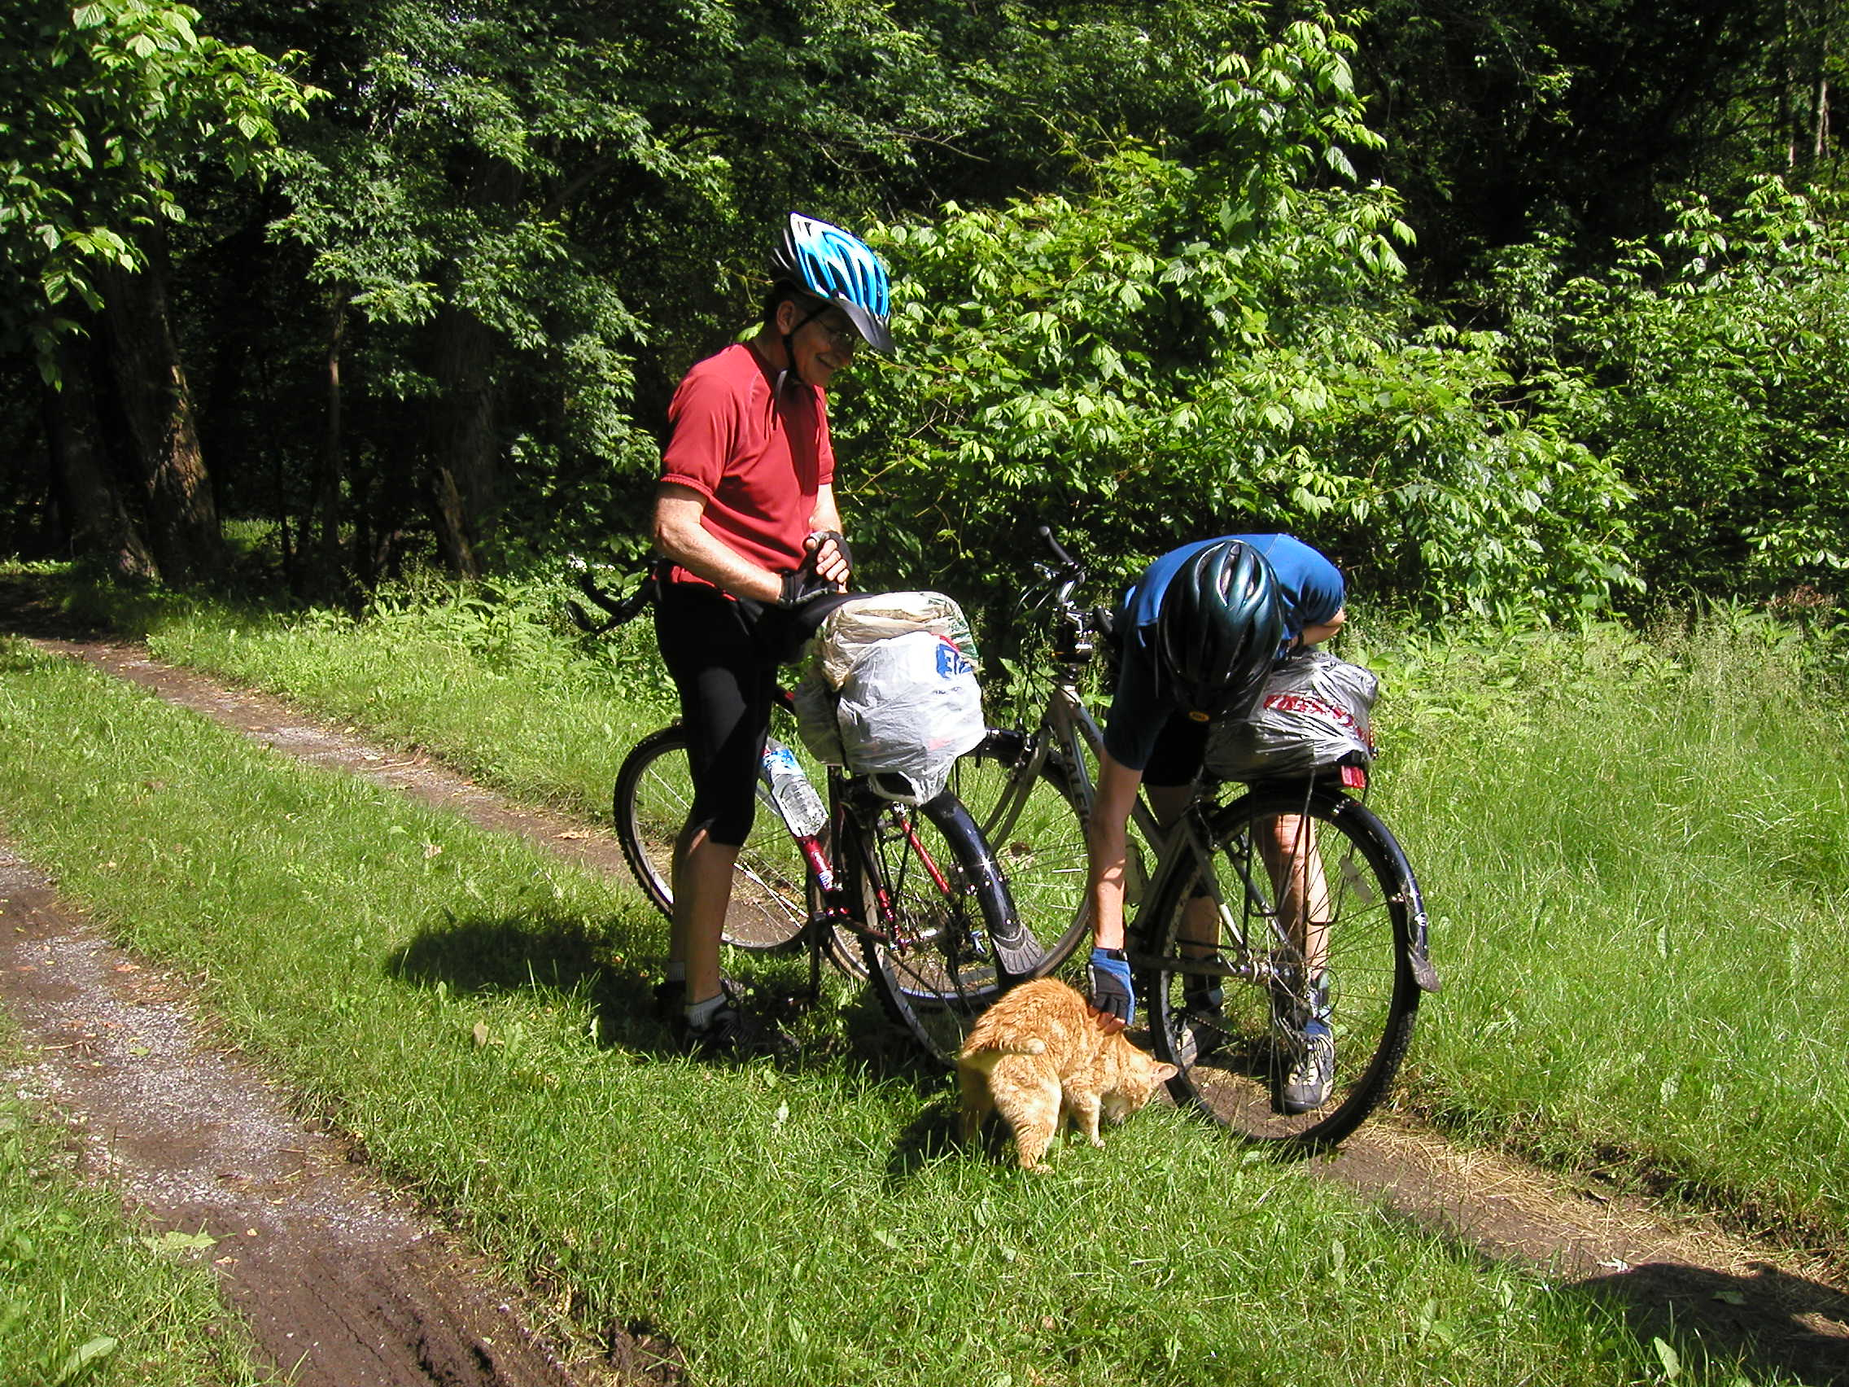
Notes:
Before xition: Not too bad
After transition: Getting narrow.

Slide 29
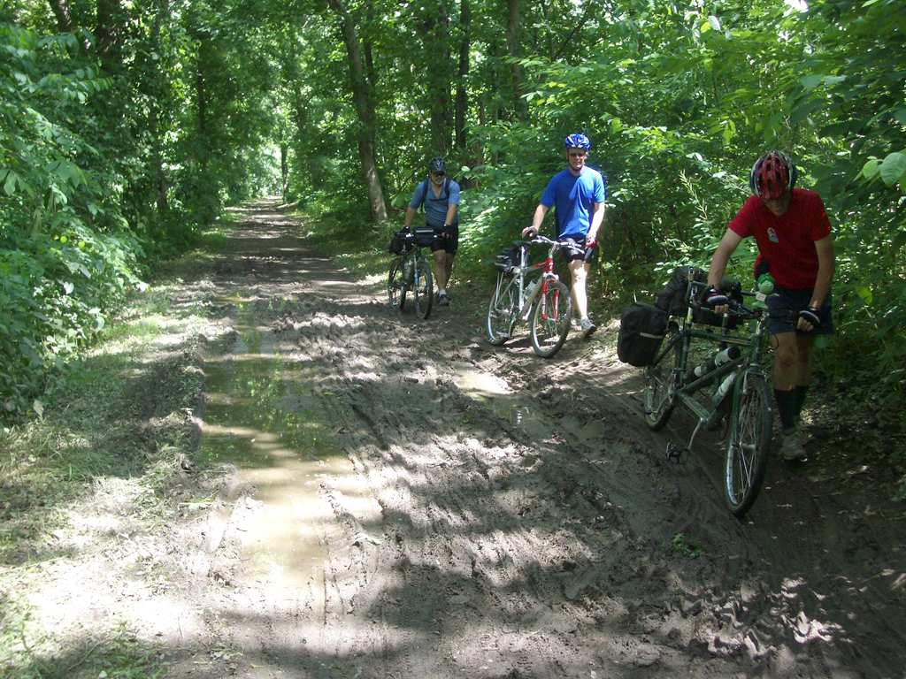
Notes:
After xition: Yuck

Slide 30
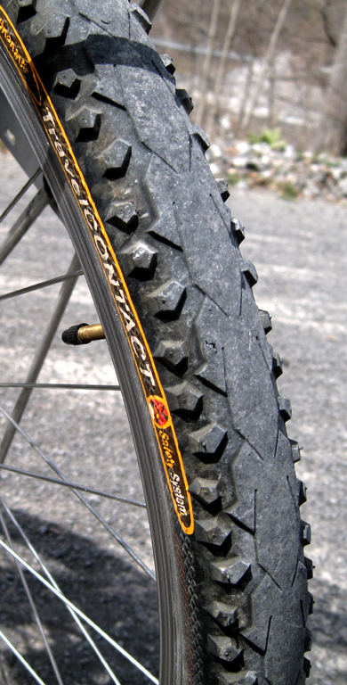
Hybrid, mountain, and touring bikes work fine
Use tires with some tread
Use good wheels
Be sure the bike is in good condition
Carry stuff on a rack
Lightweight skinny-tired road bikes don’t do well
Notes:
What kind of bike and tires do I need to get through that

Slide 31
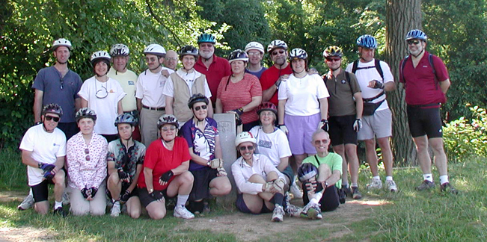
Can we do it?
Can you ride 30 miles both days of a weekend?
Are you in reasonably good health?
Notes:
Can I do it?

Slide 32
The Four Big Decisions
Direction: eastbound or westbound?
Distance: how far should we ride daily?
Support: how much do we need?
Luxury: what kind of lodging?
Notes:
Okay you convinced me. What do I have to decide

Slide 33
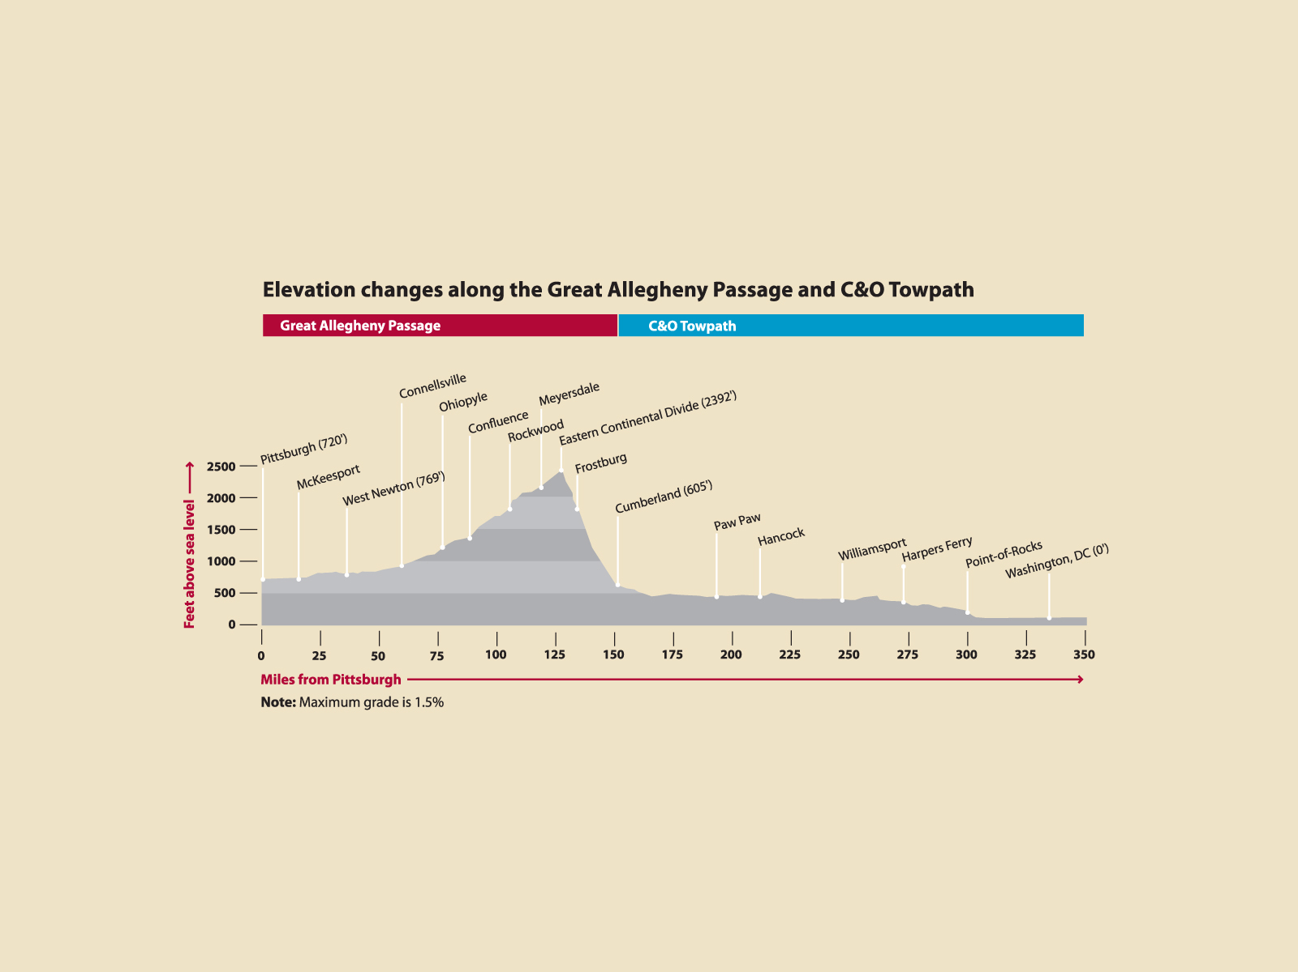
Which Direction?
ADA ramps are five times this steep!
Notes:
After xition: That looks STEEP!!!

Slide 34
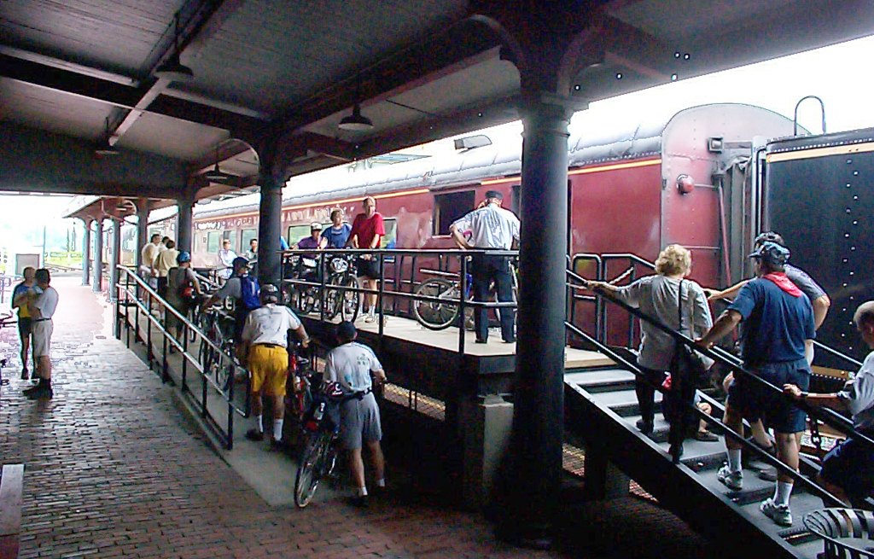
Notes:
After xition: Think I will take the train
Before xition: OK, then how far will I have to ride each day?

Slide 36
How far to ride each day?
350 trail miles between DC and Pittsburgh
10 days at 35 miles/day 8 days at 45 miles/day 6 days at 60 miles/day 5 days at 70 miles/day
Plus distance to lodging if not camping
Plus time to visit nearby attractions
Plus allowance for rain, repairs
Remember, the surface is not asphalt
Notes:
<pause> … That’s an easy decision 8 days, a week plus a day. I can take my week’s vacation and use the weekends before and after
Before xition: How does that work out?

Slide 37
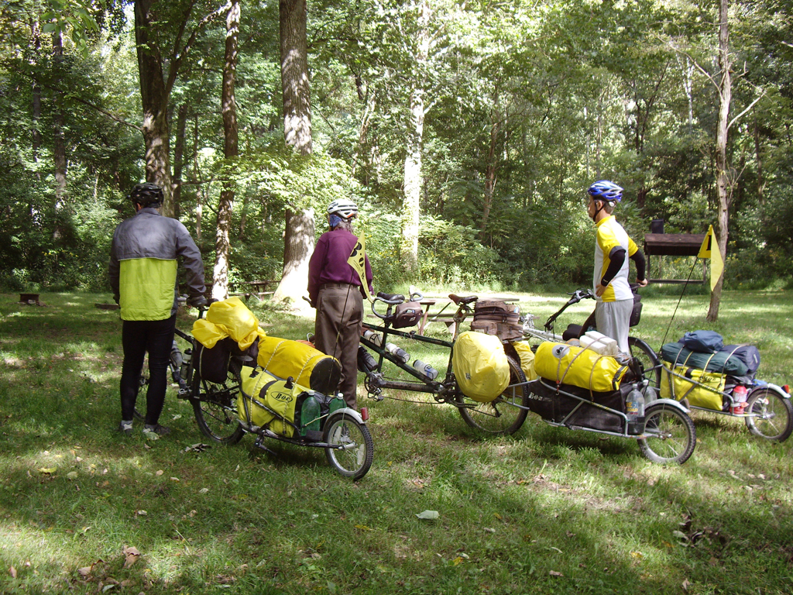
Self-contained trips carry everything they need …including house and kitchen if camping
Notes:
Before xition: Camping means you have to haul a lot of stuff -- Sounds like work -- Besides, I like my pillow and hot shower! How about getting someone else to do the heavy lifting?

Slide 38
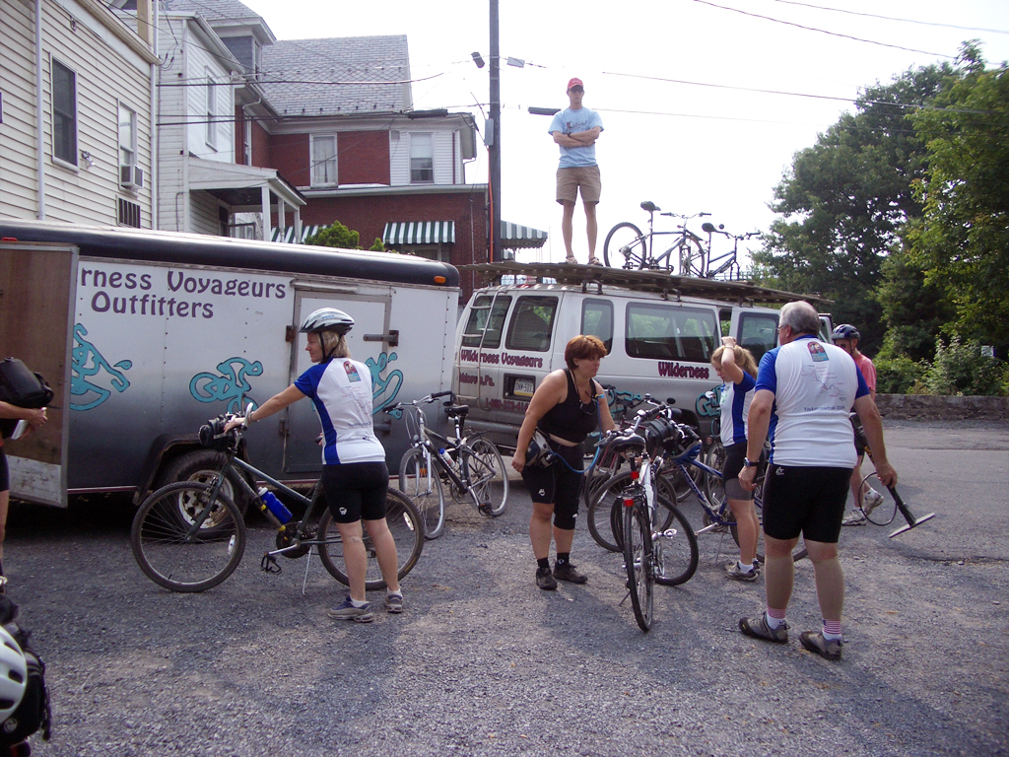
Lightly- and fully-supported trips use a vehicle to transport baggage

Slide 39
People also ask us …
Where will we sleep? Where will we eat?
How do we get to the trail and back?
What if it rains?
What can go wrong? Is it safe?
Notes:
Before xition: babble

Slide 40
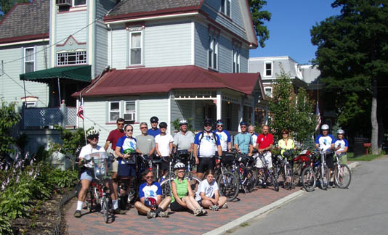
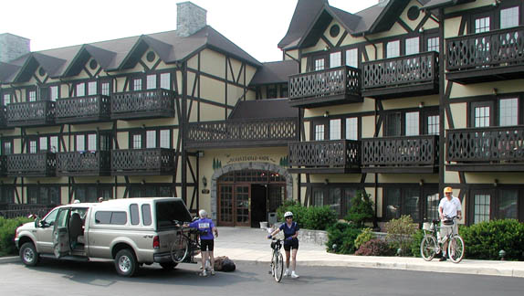
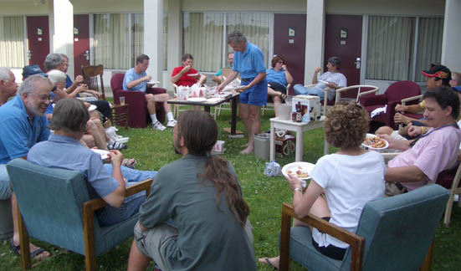
Indoor Lodging
Hotel, B&B, motel
Notes:
Where will I stay

Slide 41
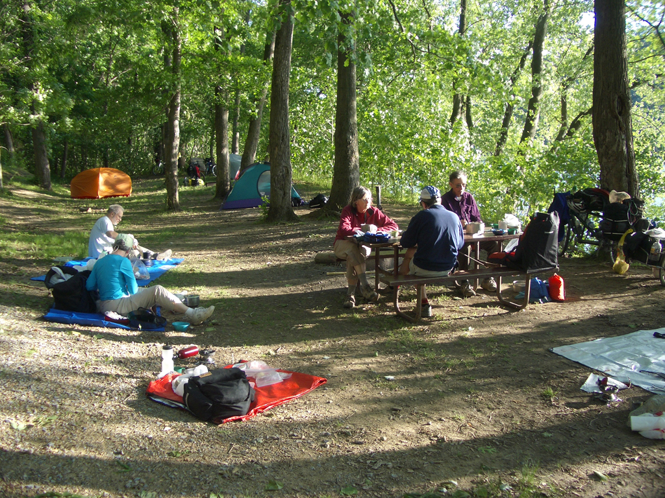
Primitive camping beside the trail

Slide 42
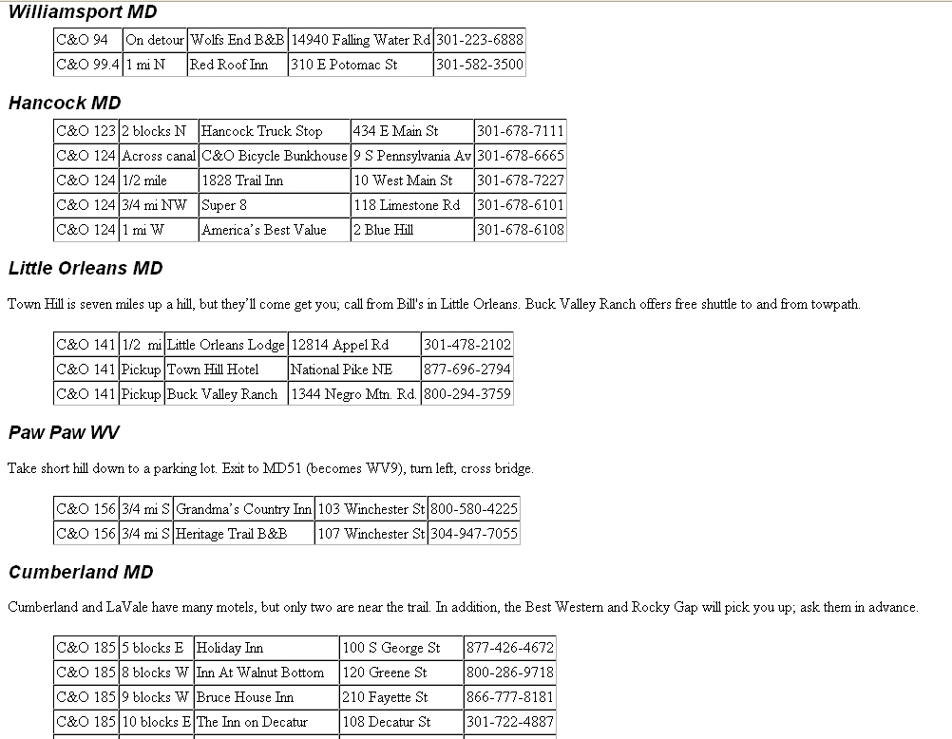
From Linking Up
and
http://linkup.shaw-weil.com
Note 25- to 30-mile gaps between lodging
Notes:
Where can I find some detail information. Start with “Where do I sleep”

Slide 43
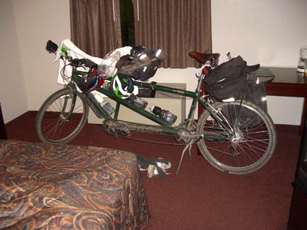
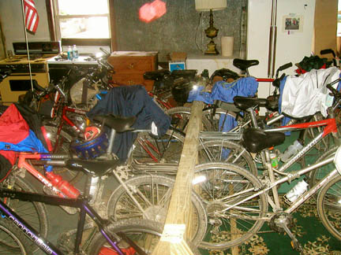
Where will my bicycle sleep?
Lodging along the trail knows about bicycles
Notes:
How do I keep my bike save so it will be there in the morning

Slide 44
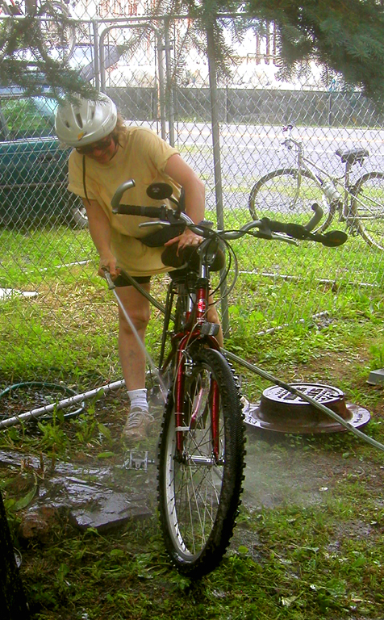
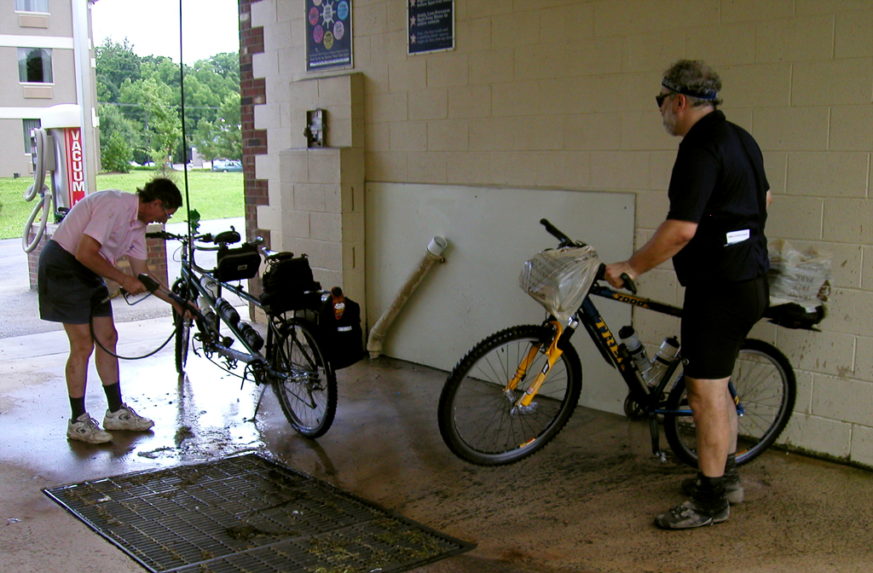
… but if it’s raining…
Wash the bike, please There should be a hose handy
Notes:
What if it has been raining, and we’re all dripping mud?

Slide 45
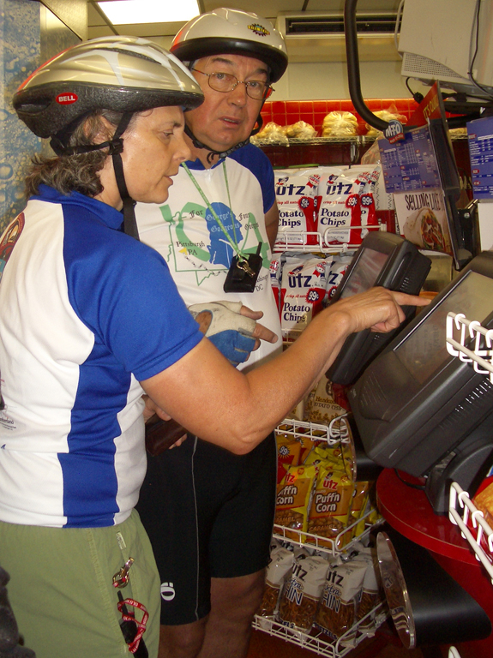
Where will we eat?
Notes:
Can I find places to eat?

Slide 46
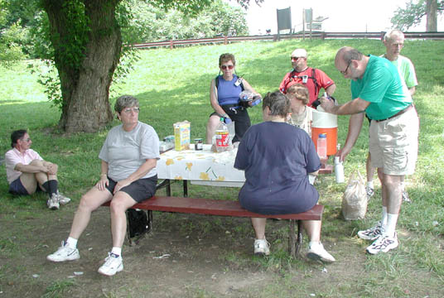
Where will we eat?

Slide 47
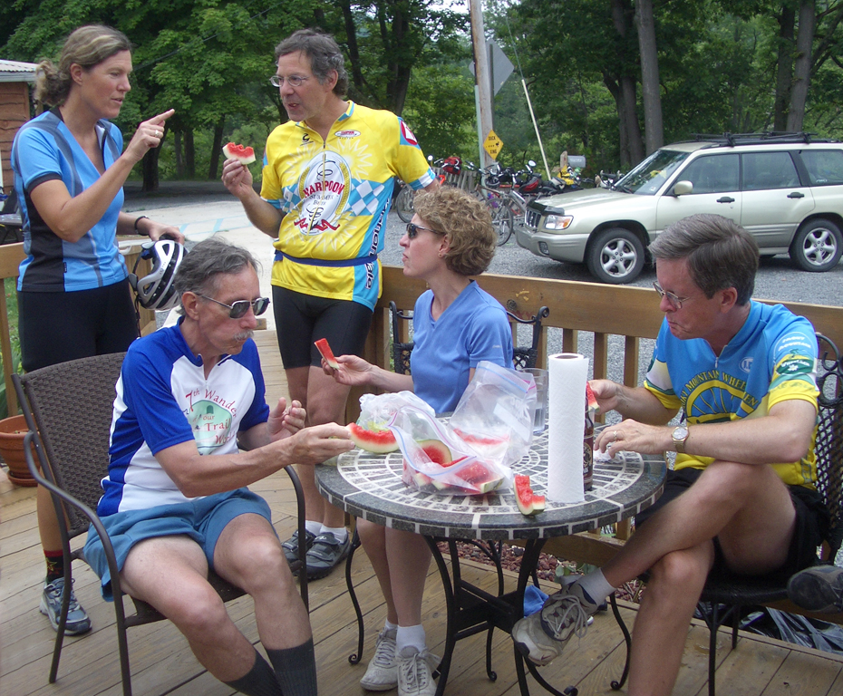
Where will we eat?

Slide 48
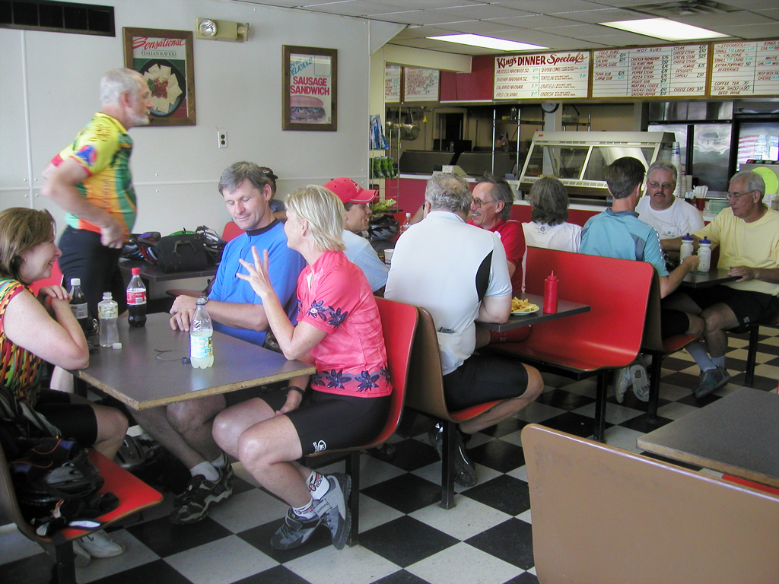
Where will we eat?

Slide 49
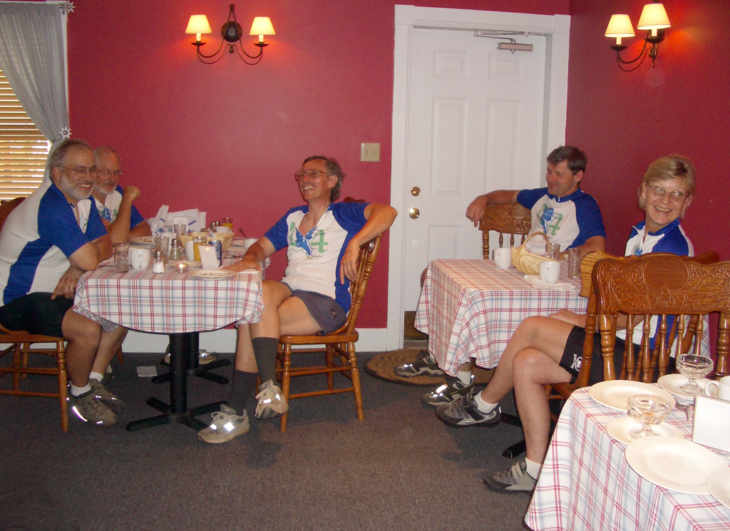
Where will we eat?
Notes:
Before xition: How do I get the start?

Slide 50
People also ask us …
Where will we sleep? Where will we eat?
How do we get to the trail and back?
What if it rains?
What can go wrong? Is it safe?
Notes:
Before xition: babble

Slide 51
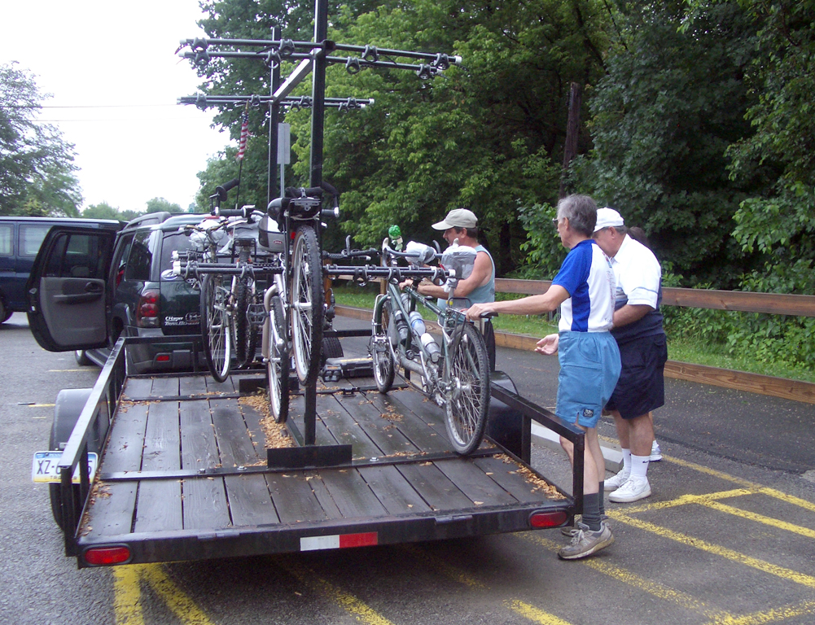
Get to the trail
by hiring someone
to drive you
To and from trail
Notes:
before xition: any other options?

Slide 52
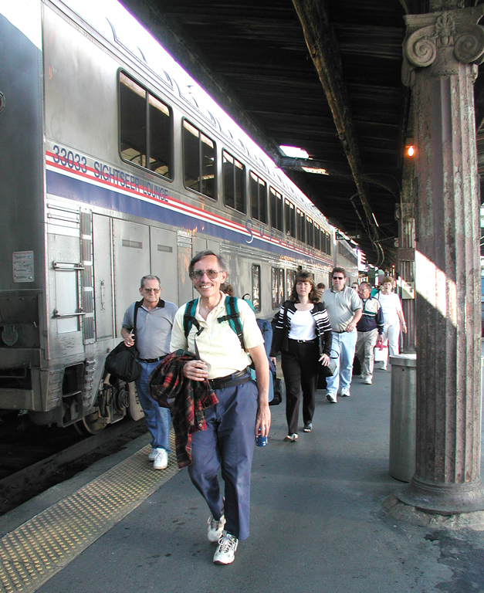
Get to the
trail by taking
the train
You can check bikes between Pittsburgh and Washington
Notes:
After xition: Never been on a train before. What’s it like?
Before xition: Can I fly?

Slide 53
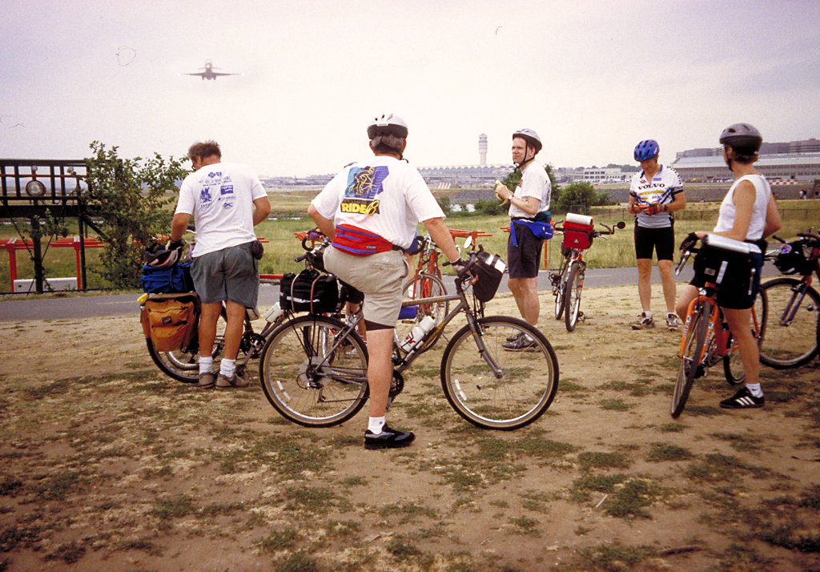
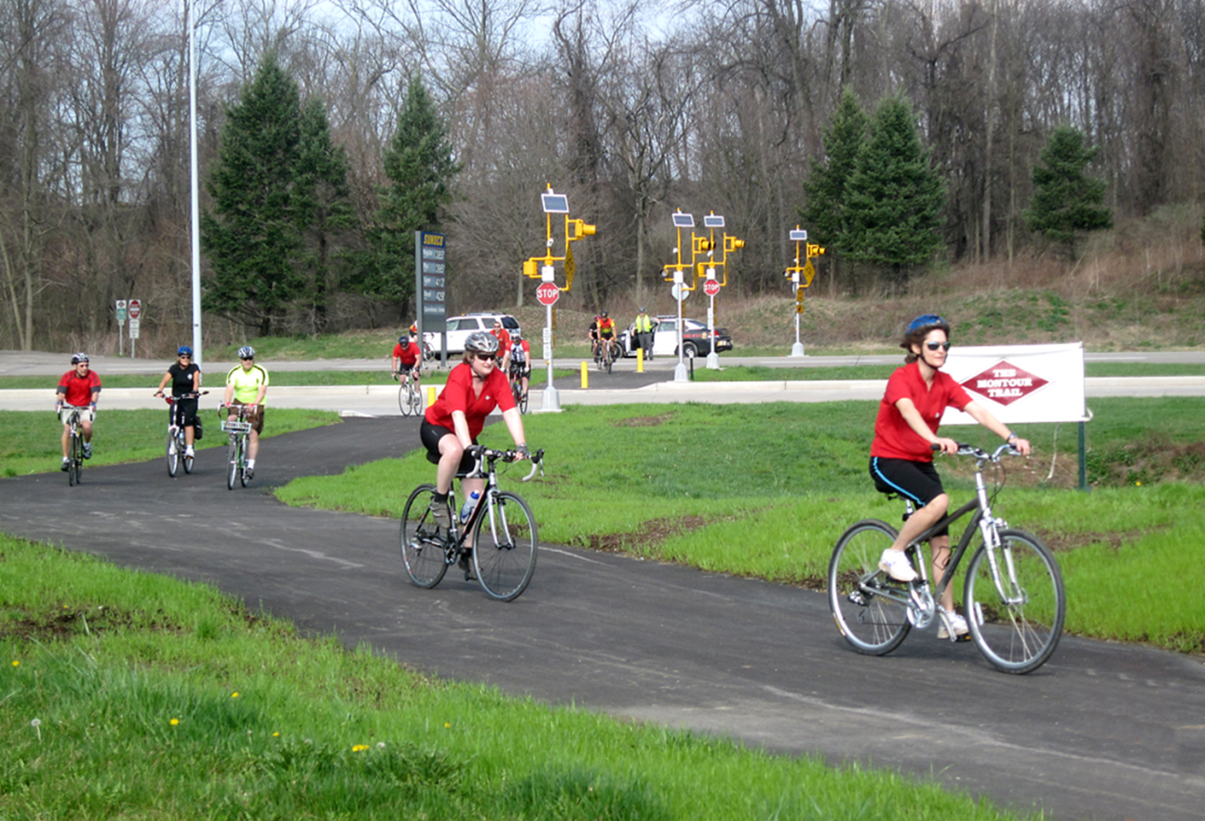
NEW!!
Get to the trail
in Pittsburgh by
taking the airplane
A new spur from the Montour Trail now connects to Pittsburgh airport
Notes:
After xition: When did that happen?
Before xition: where does this trail go?

Slide 54
Notes:
Before xition: Back to the question of what happens if it rains?

Slide 55
People also ask us …
Where will we sleep? Where will we eat?
How do we get to the trail and back?
What if it rains?
What can go wrong? Is it safe?
Notes:
Before xition: babble

Slide 56
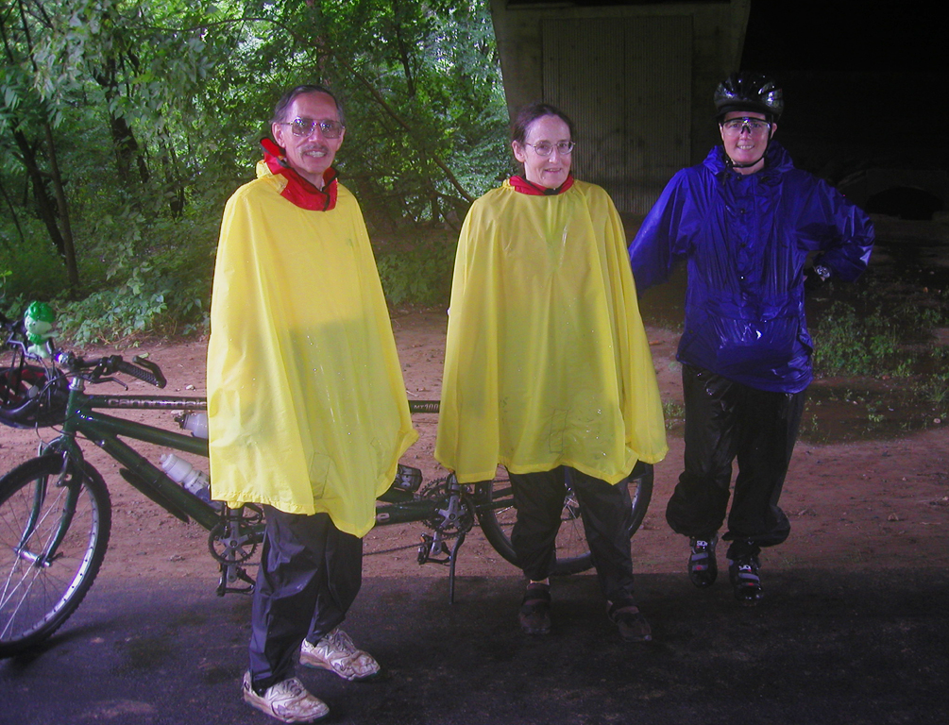
What if it rains
What if it rains?

Slide 57
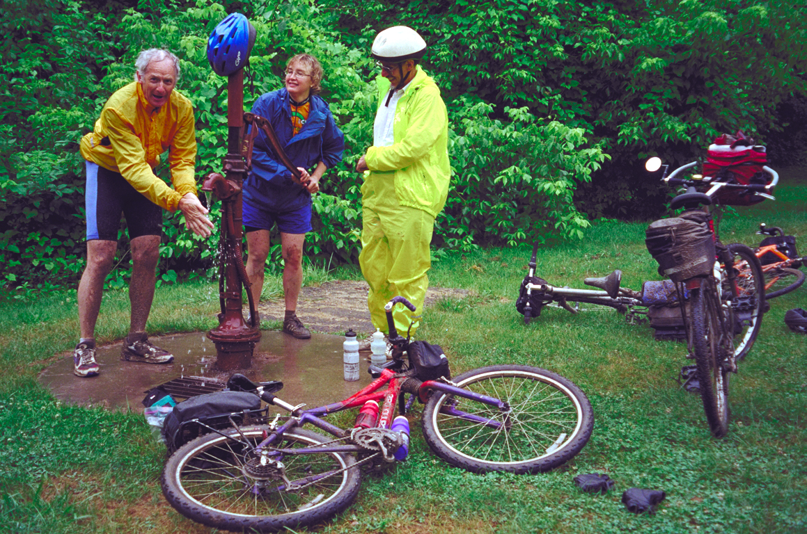
You get wet!

Slide 58
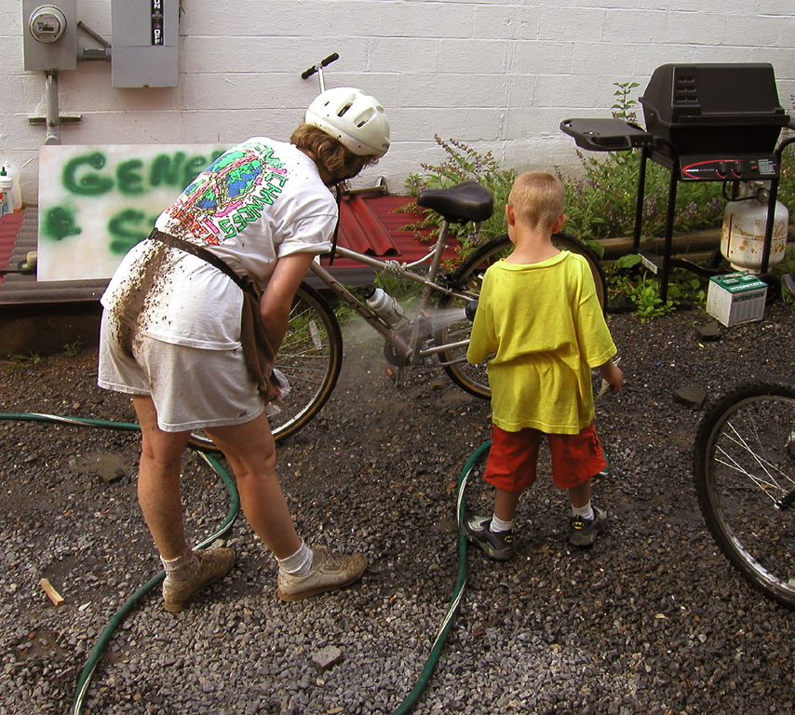
You clean up!

Slide 60
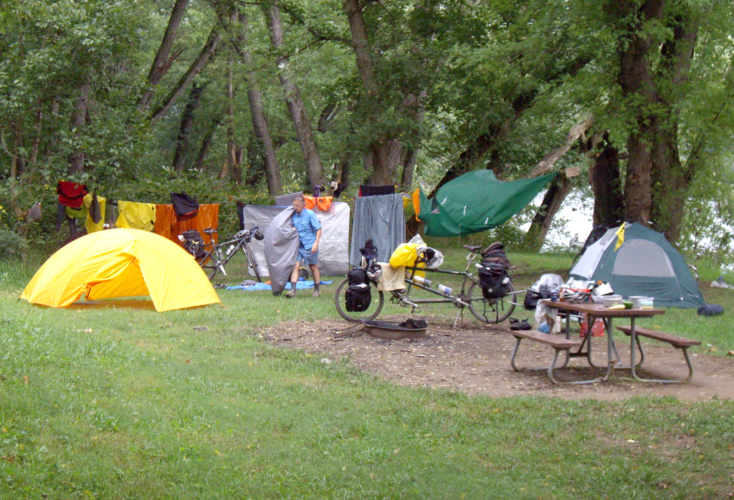
You dry out!
Notes:
Before xition: What can go wrong? Is it safe?

Slide 61
What can go wrong?
Minor mechanical problems
Bumps, bruises, poison ivy
Poor phone coverage
Almost no auto traffic
Good safety record
But it’s all real – no safety rails

Slide 62
Notes:
I took a class on that. That I can do

Slide 63
Poison Ivy
Notes:
How much is there

Slide 64
Put yourself in this picture!
Notes:
I will do it!

Slide 65
Notes:
How will I convince my friends that I did it?

Slide 66
Online resources
Our site http://linkup.shaw-weil.com
Great Allegheny Passage http://gaptrail.org/
C&O Canal (NPS) http://www.nps.gov/choh
Bike C&O http://www.bikecando.com/
Bike Washington C&O Guide http://bikewashington.org/canal/index.php
Notes:
How about online resources?

Slide 67
$
Economic
Impact

Slide 68
Pittsburgh to Cumberland
6 studies/surveys completed 1998-2015
by Trail Town Program® and partners
Estimated Trail Usage: 940,000 (2013)
Estimated Overall Direct Economic Impact: $50 Million (2012)
Average Day User Spends: $18 per day (2014)
Average Overnight Guest Spends: $124 per night (2014)

Slide 69
Business Activity and Impact
137 new trail-related businesses opened in the Trail Towns since 2007. There were 72 business closings, with net gain of 65
270+ net new jobs were created
25 businesses expanded operations and 15 changed hands during this period.
Estimated Sales Related to Trail Traffic: 2008: 25%, 2012: 30%, 2013: 34%, 2014: 40%

Slide 70
Volunteer Opportunities
These trails have been developed largely through the efforts of many, many volunteers
Notes:
How did it come about that we have this great trail?

Slide 71
‘You get to
play in the dirt

Slide 72
You get down to
the nuts and bolts
Notes:
SO, Why did you drag all of us here tonight?

Slide 73
You get to meet new people

Slide 74
‘You get to play
with power tools

Slide 75
You get to plan and organize

Slide 76
You get to play
in the street

Slide 77
You even get to breathe fire!

Slide 78
Maybe you’ll get to play with the big toys

Slide 79
Your local trail groups invite your participation
Check for regular meetings and work parties
They need both volunteer time and funds
Please support them in whatever way you can
Notes:
Will do!

Slide 80
Questions?
Notes:
I am out of questions. How about you guys?

